Slide 1
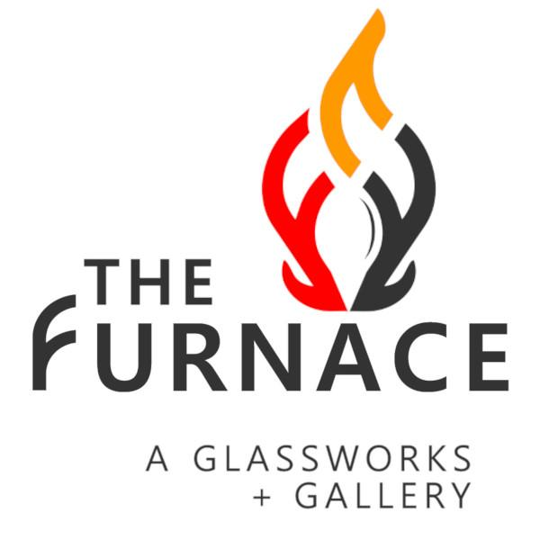
The Furnace:
A Glassworks + Gallery
8090 W Colfax Ave
Hotshop, Coldshop,
Gallery, Rentals
Corey & Leanne Silverman
Notes:
History of The Furnace in Lakewood. Mainly focused on wholesale production and classes for several years. Big desire to branch out to having a gallery of our own and better presentation in a gallery district i.e. 40 west. 8090 opportunity came up in 2019. Didn’t work then. Came up again in 2020 and we jumped on it. Now we offer everything that we wanted to in a great presentation at 8090. Live glass blowing, classes, studio rentals, retail gallery and special events/private parties.
Quick background on Corey and Leanne. Corey art school yada yada. Leanne academic publishing yada yada. We always wanted to run a business together and now we do. Combined we have superpowers!

Slide 2
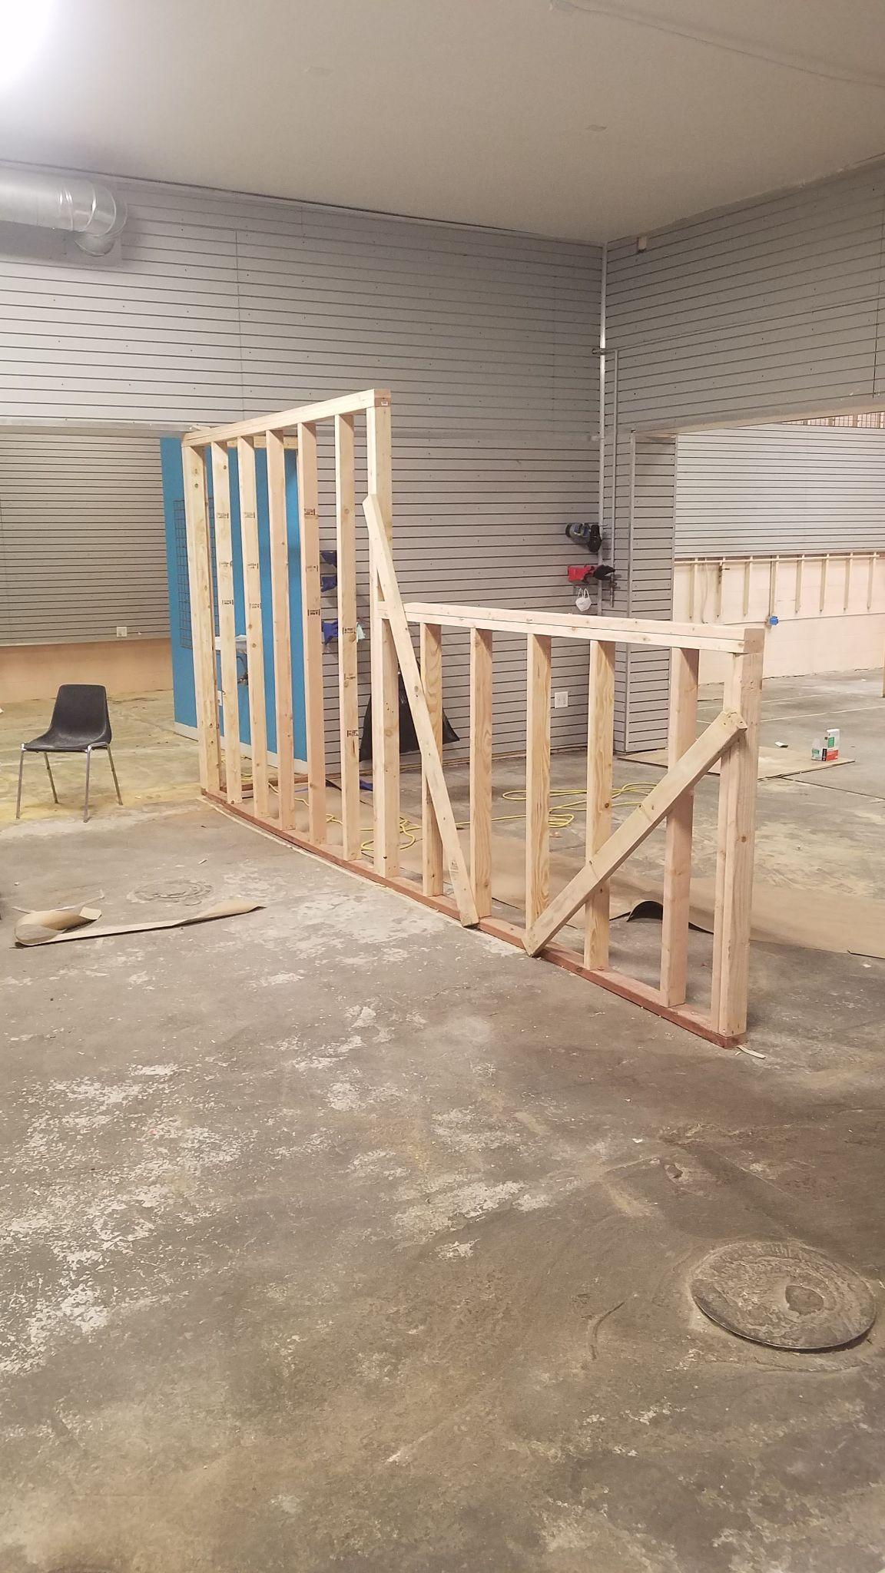
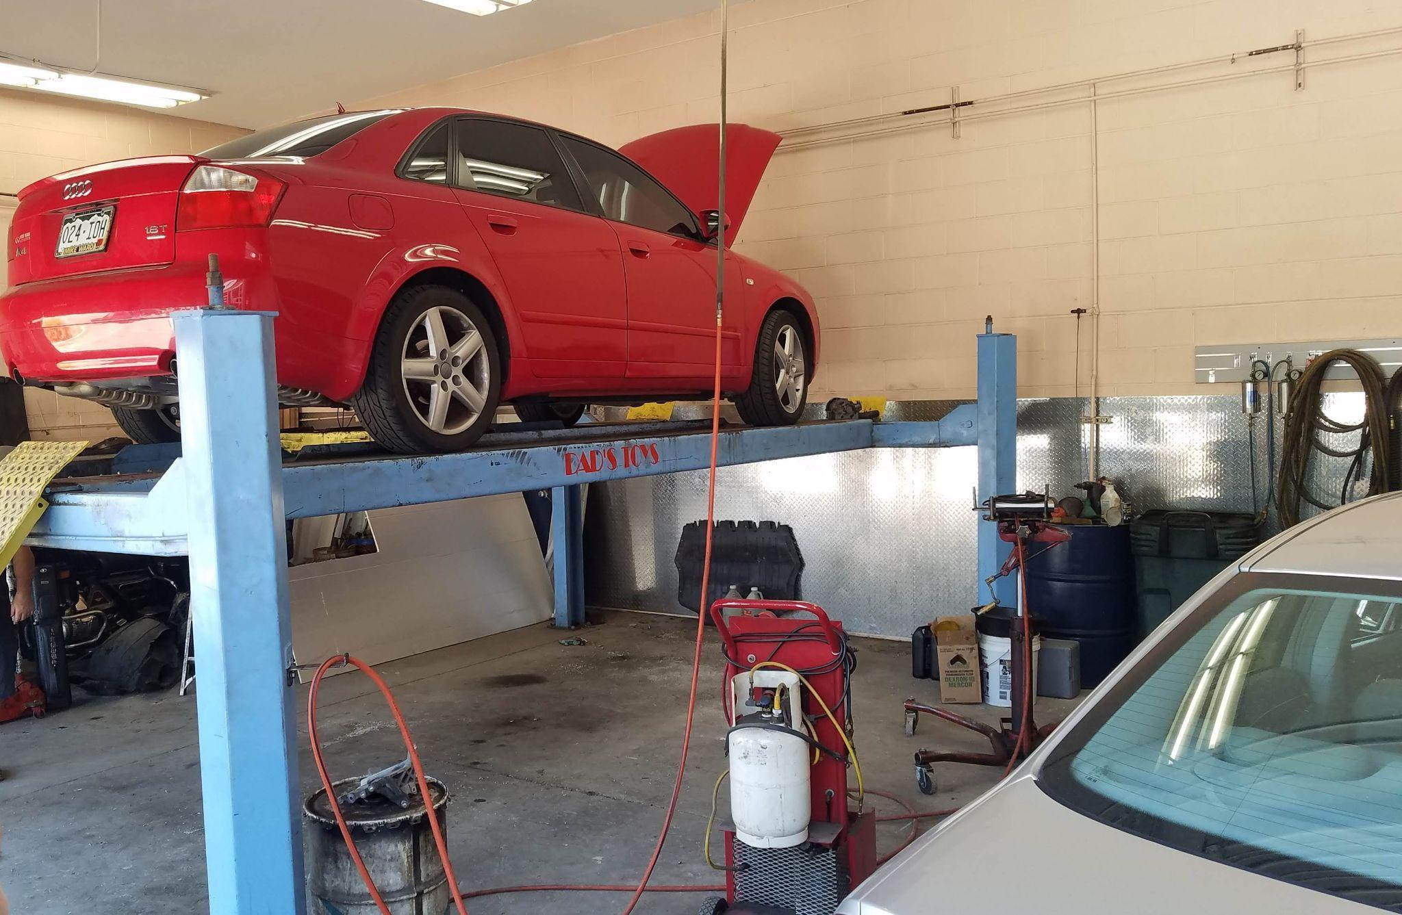
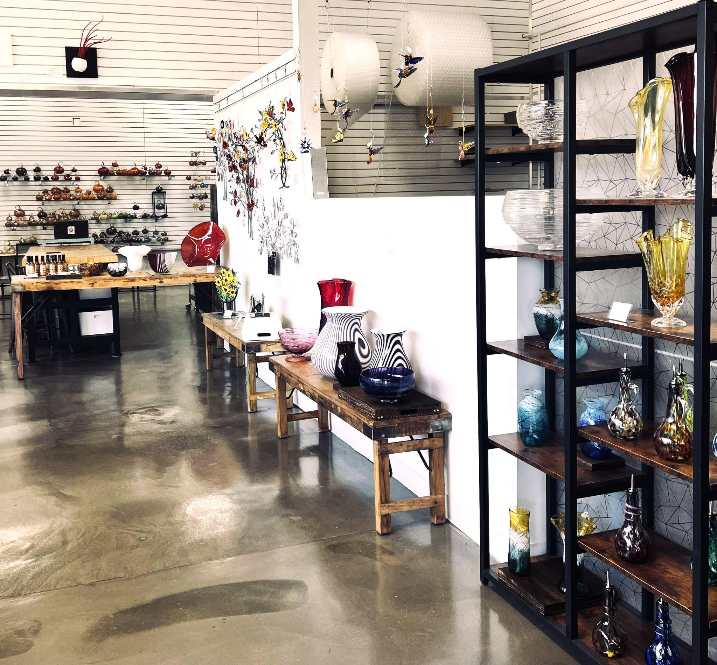
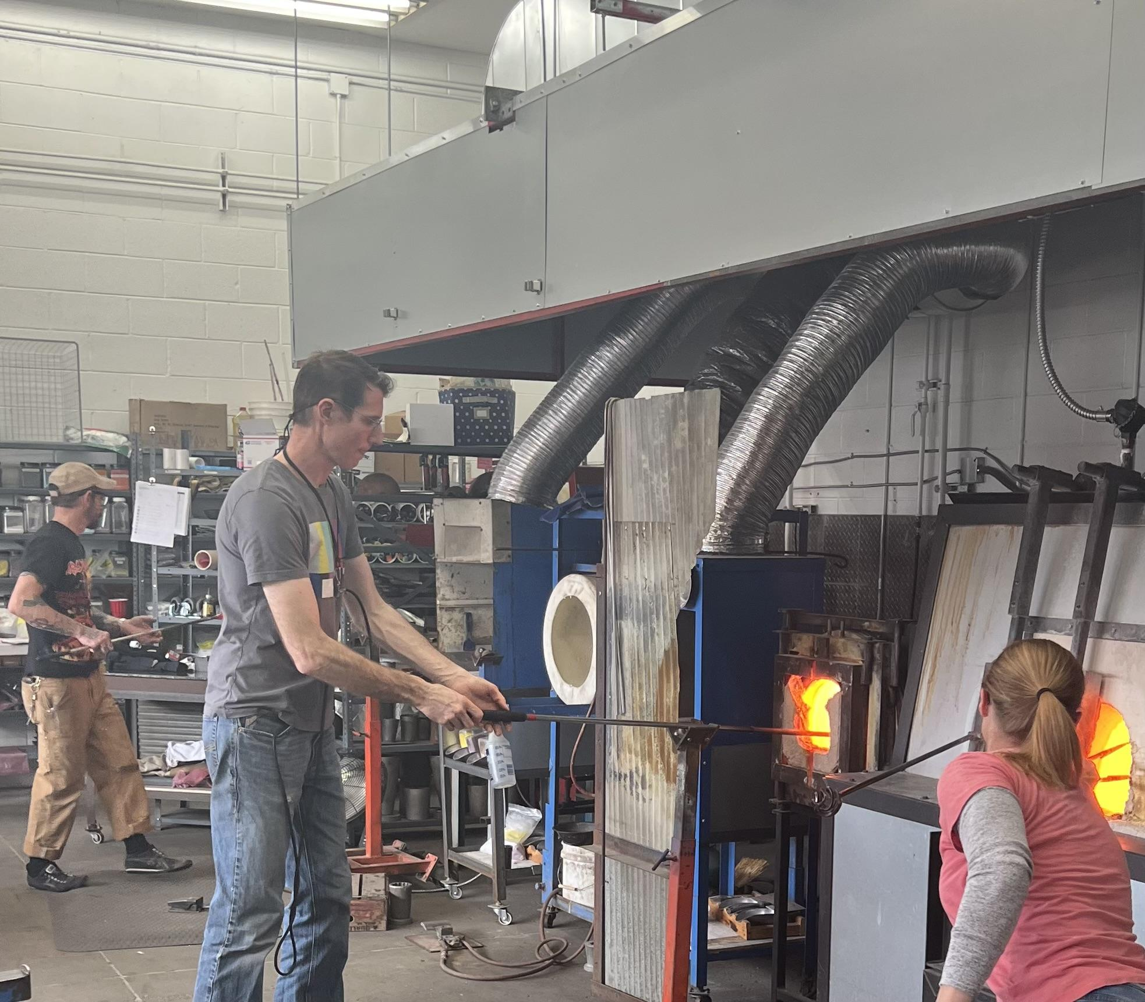
Before
After
Notes:
Previous address was had a footprint of about 2500 sqft with cramped and hot storage in a loft space. We were there from 2007 until 2022. We found 8090 in 2019 but couldn’t figure out how to get into the building at that point. In 2020 we got a different real estate rep and she helped us get it done. The day8090 is a building that housed car related businesses for the past 70 years. When we moved in, we had to change the use of the building to retail. Do we go into detail about the building? It took us 2 years to get the building built out and up to spec due to the change of use. Xcel took 12 months to get our gas line upgraded. BTW, we paid to upgrade that entire section of the neighborhood (to all the developers, you’re welcome). Mention the previous address, how long you have been in business and the process of moving. What the building was before and how long moving took. Share the story about the tendril sale when you viewed the building.

Slide 3
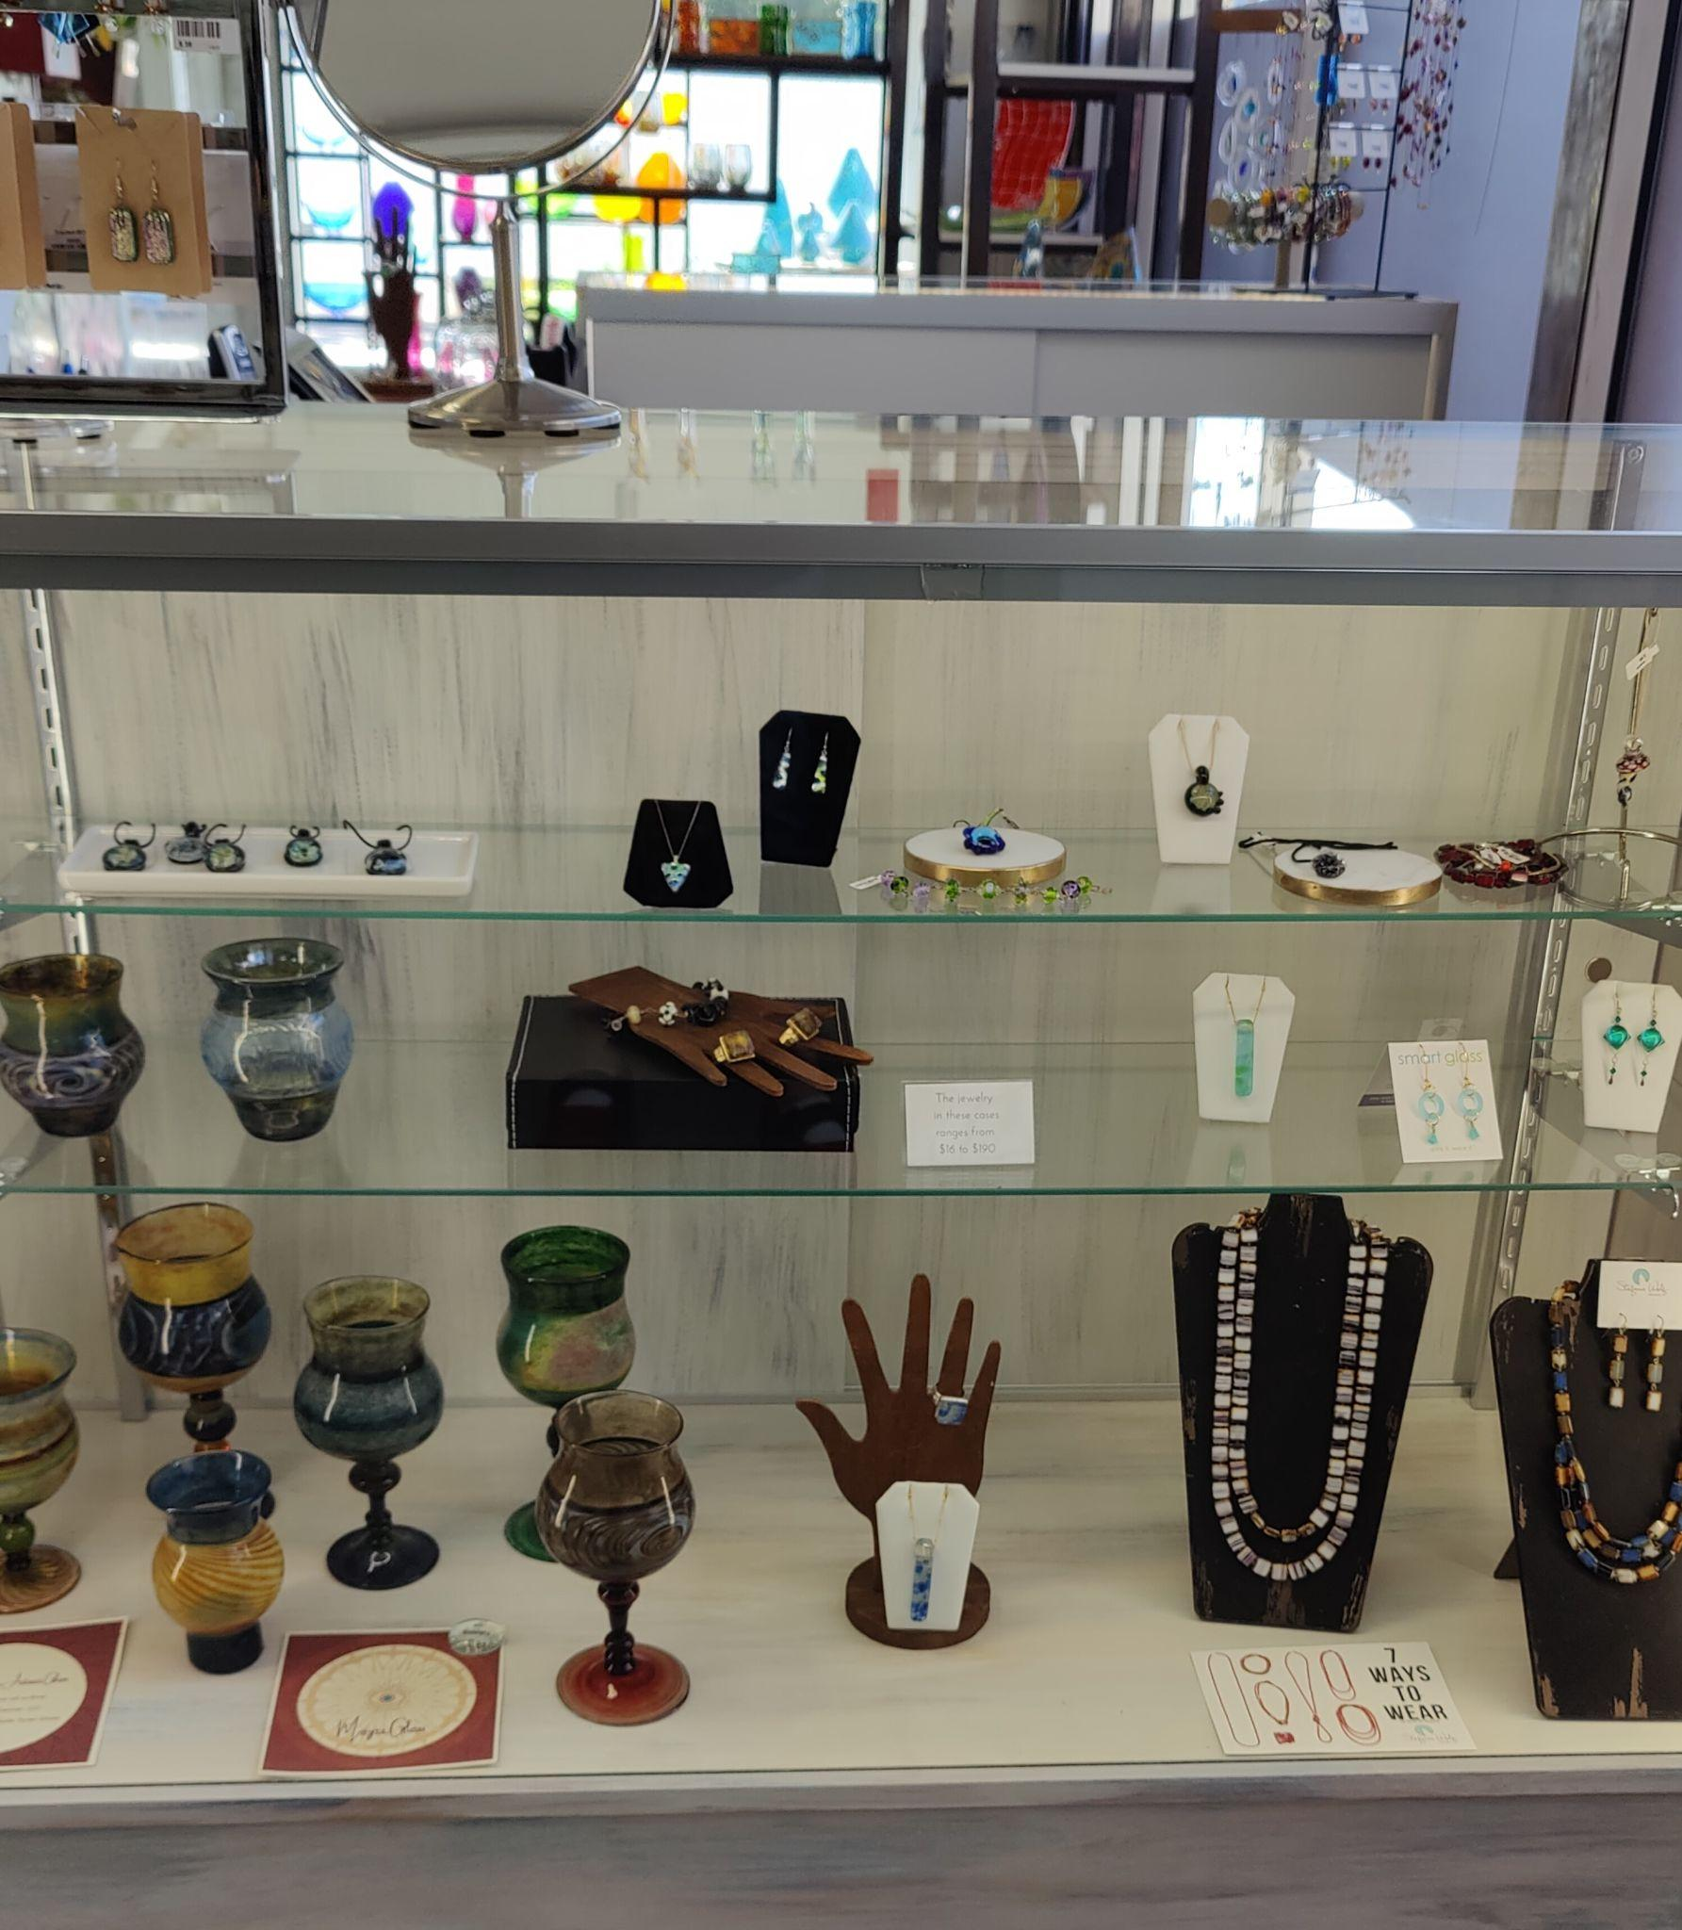
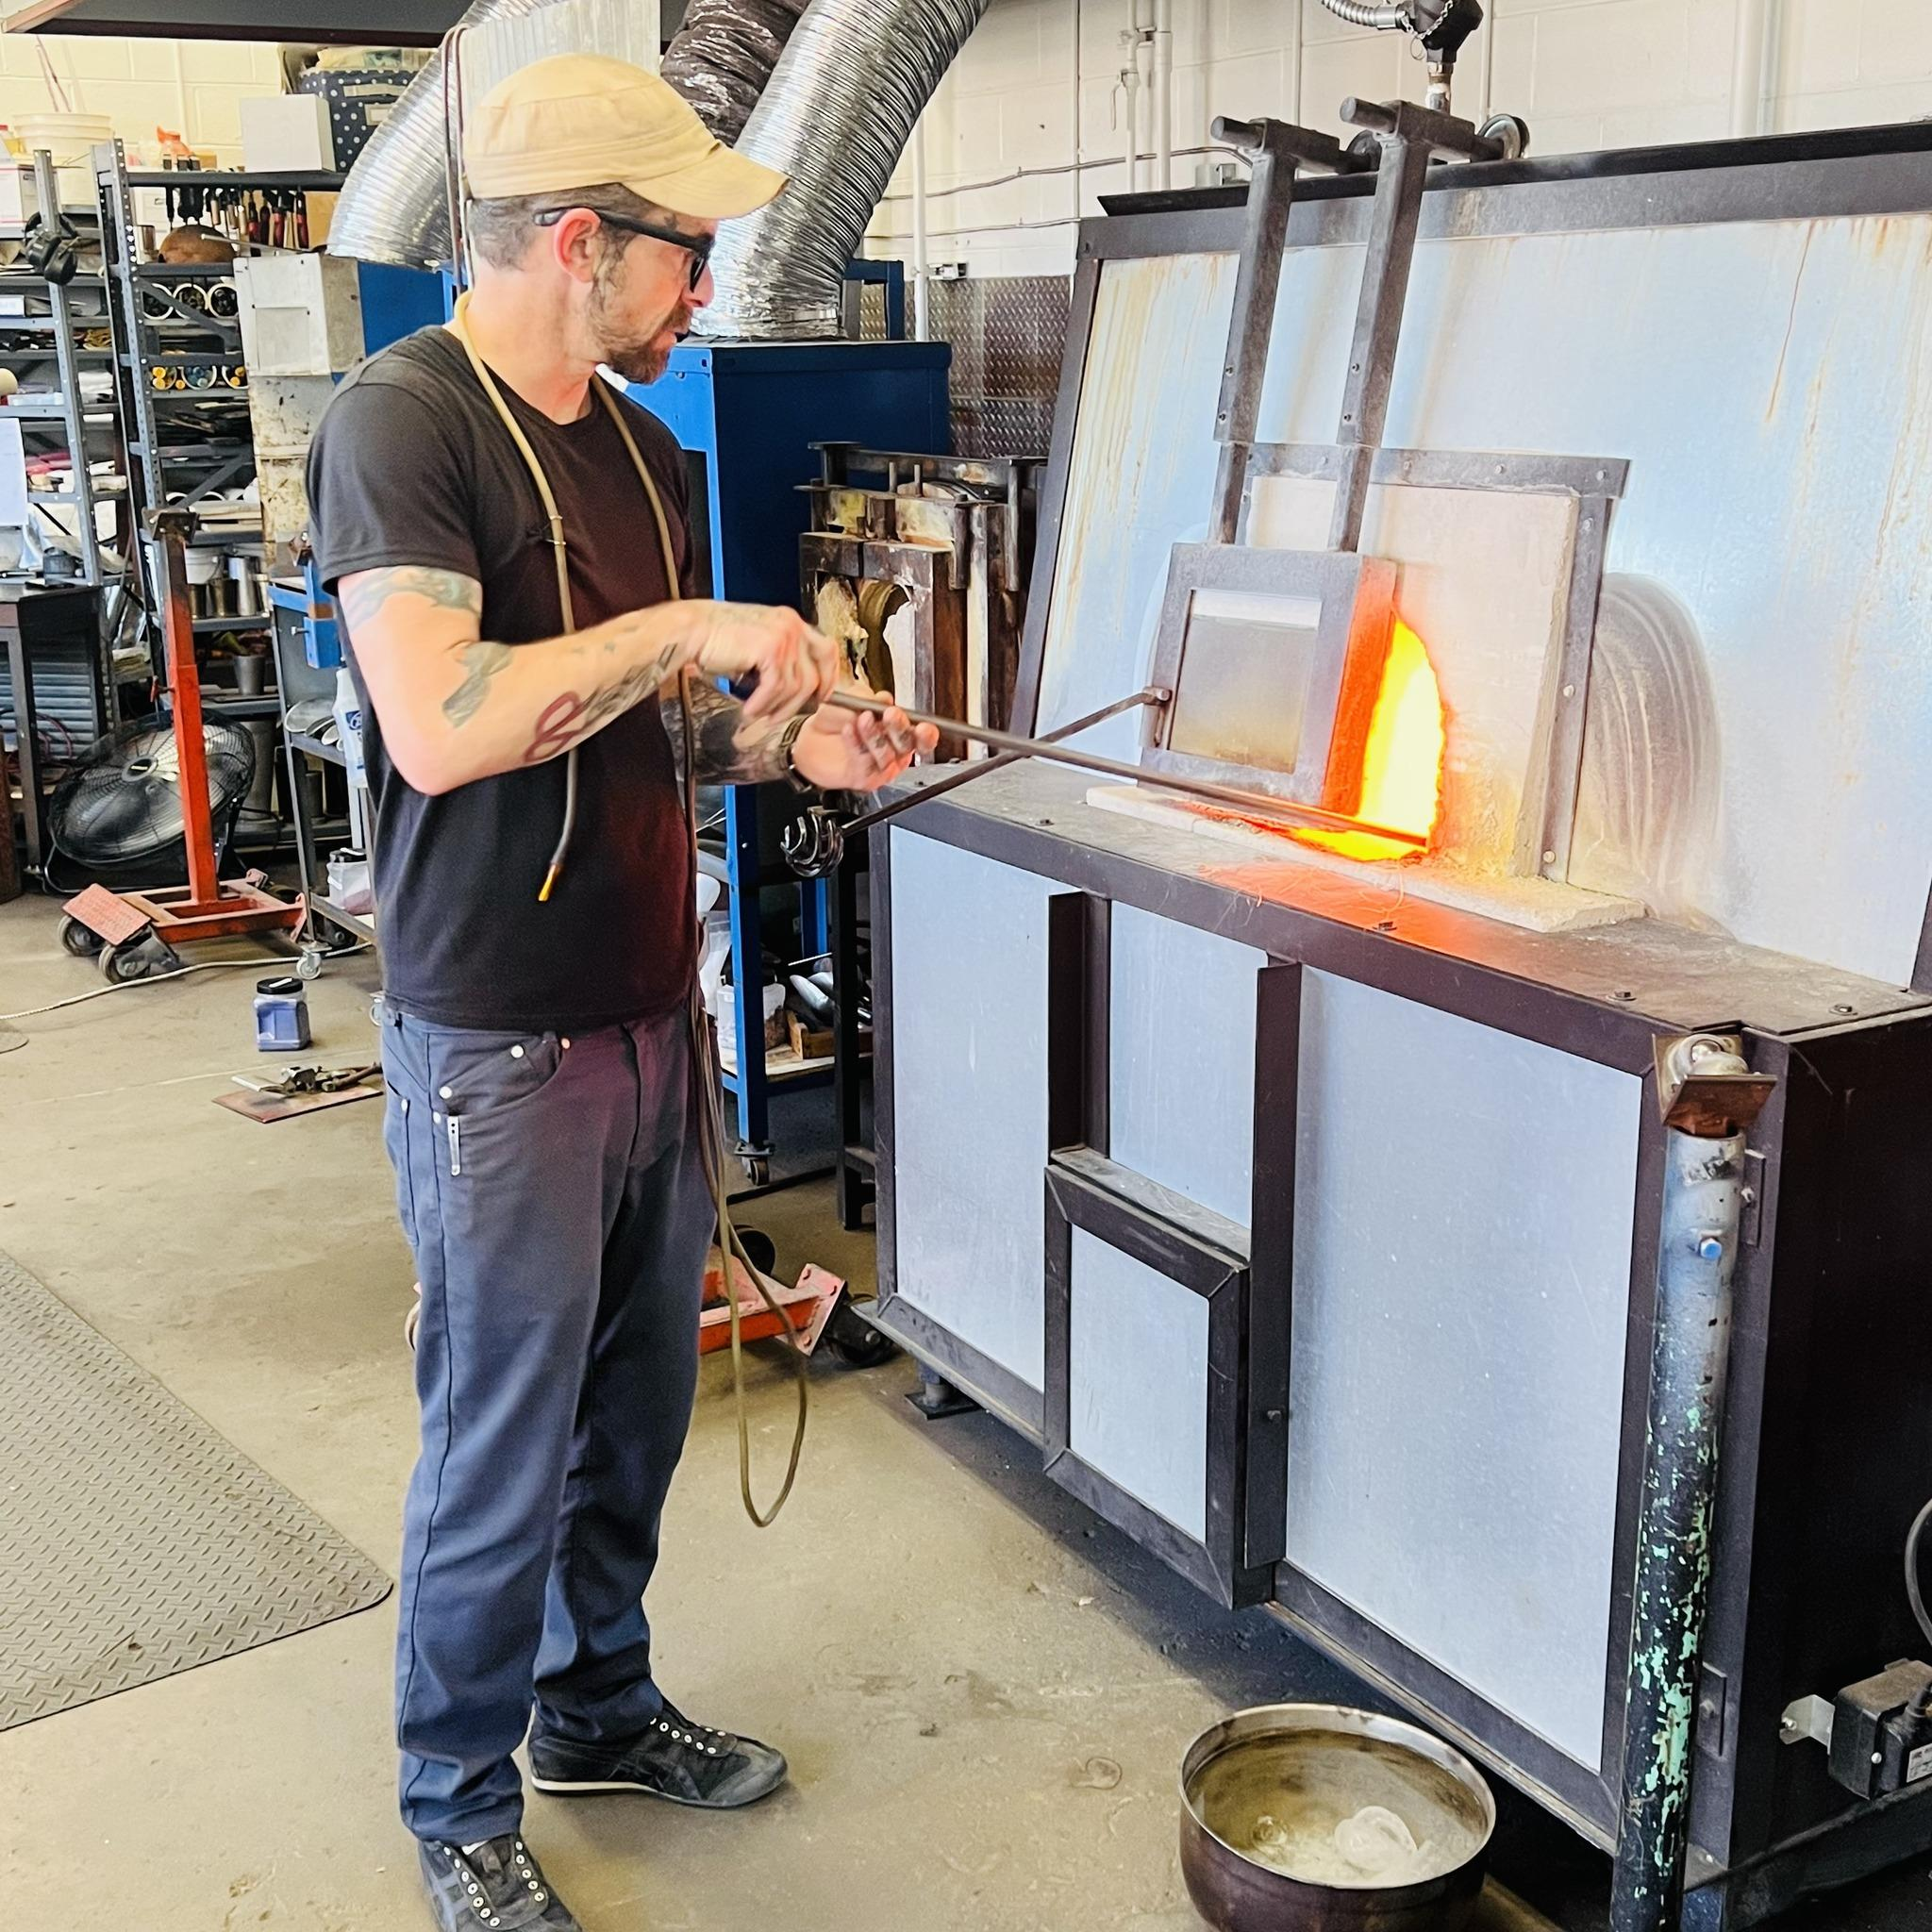
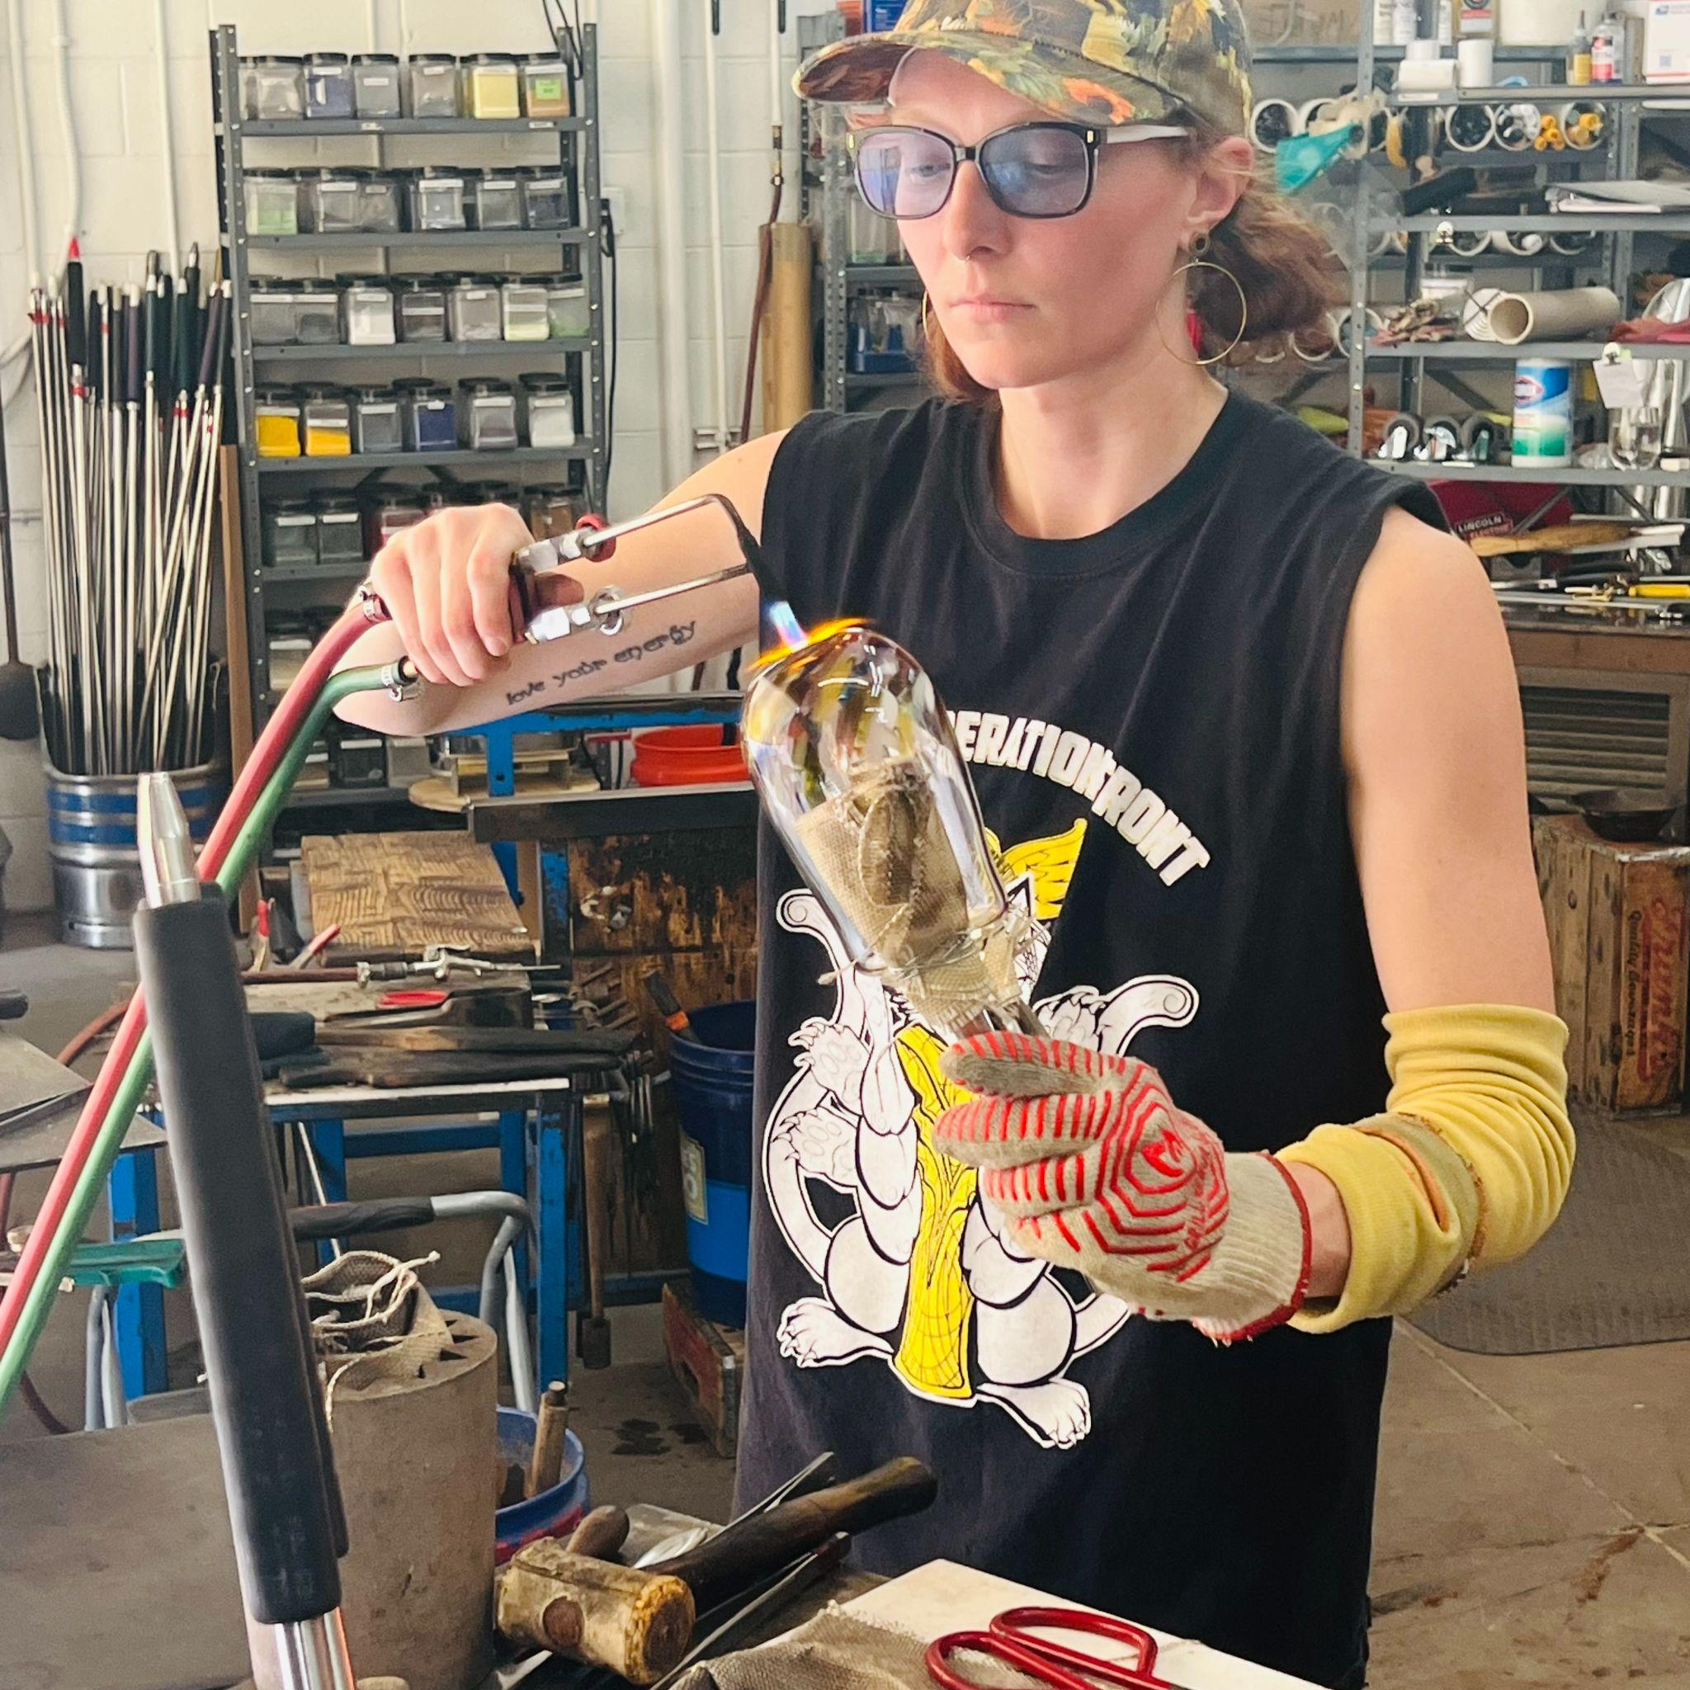
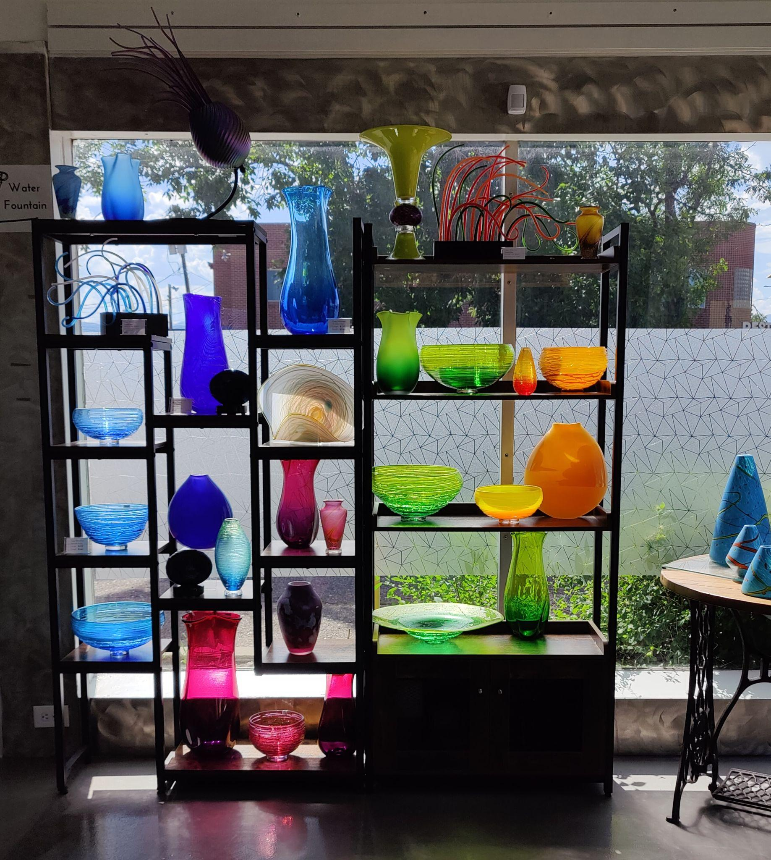
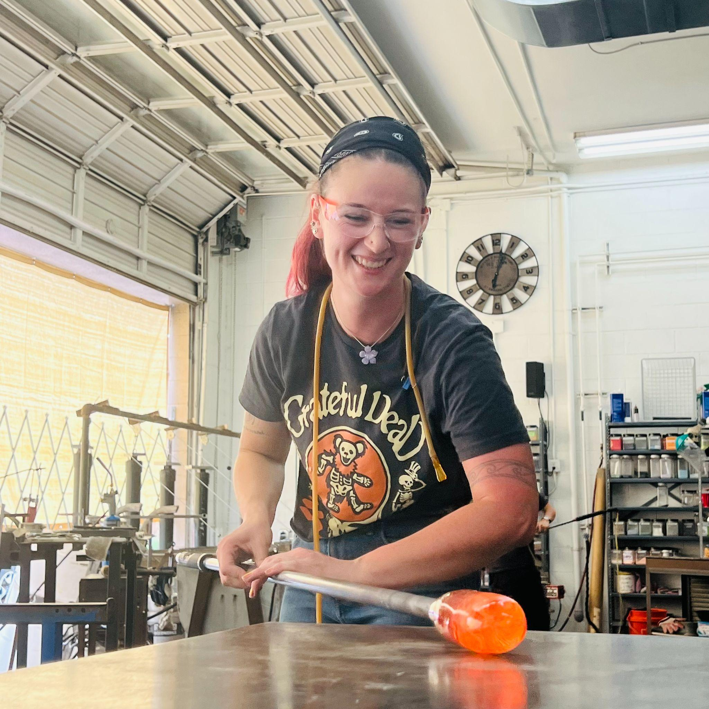
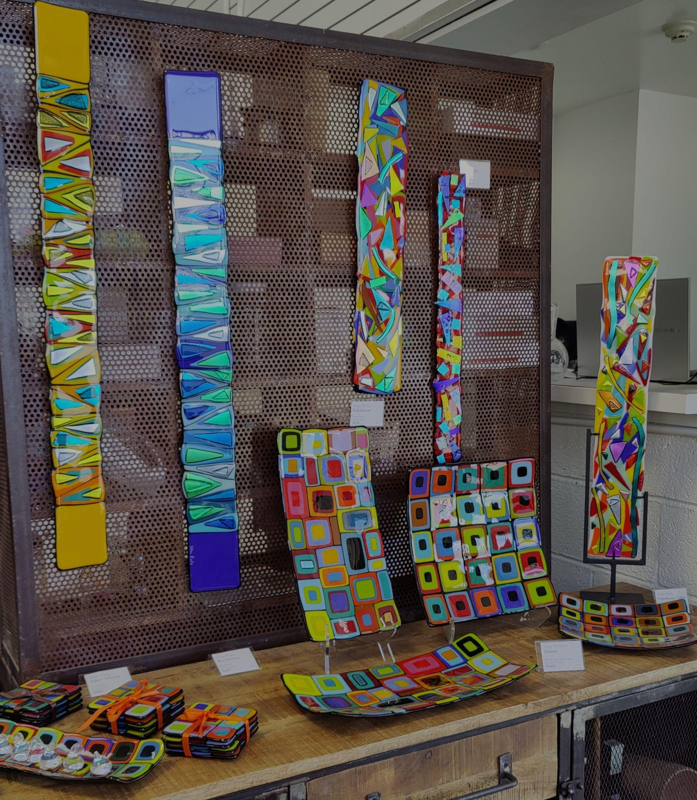
Art Gallery
Hot Shop
Notes:
Give a brief description of the gallery; notable artists, gallery events, group tours, education space and participating in 1st Fridays (Leanne). Give a brief description of the hotshop, classes and wholesale/packing & shipping area (Corey).

Slide 4
Notes:
We currently have 5 employees who work in and out of the hot shop. Our renter list is growing and is around a dozen people at this time. Our renters come in and use the hot shop to experiment and make product for their own sales. Running a hot shop can be very cost prohibitive for anyone that is considering starting up a glass studio. We offer our facility to anyone that has glass experience and wants to keep getting better at their craft without making a huge investment in equipment. Our current hot shop allows us to have a team of 3-4 people working on production items and custom work. We also have a great viewing area for anyone that wants to be in the comfort of our gallery while they watch us blow glass. Lots of people ask us what we do to make money and a large part of our business is wholesale. We have lots of products that we make and sell to other resellers across the country. We have over 100 galleries, boutiques, museum shops and catalogs that resell our products.

Slide 5
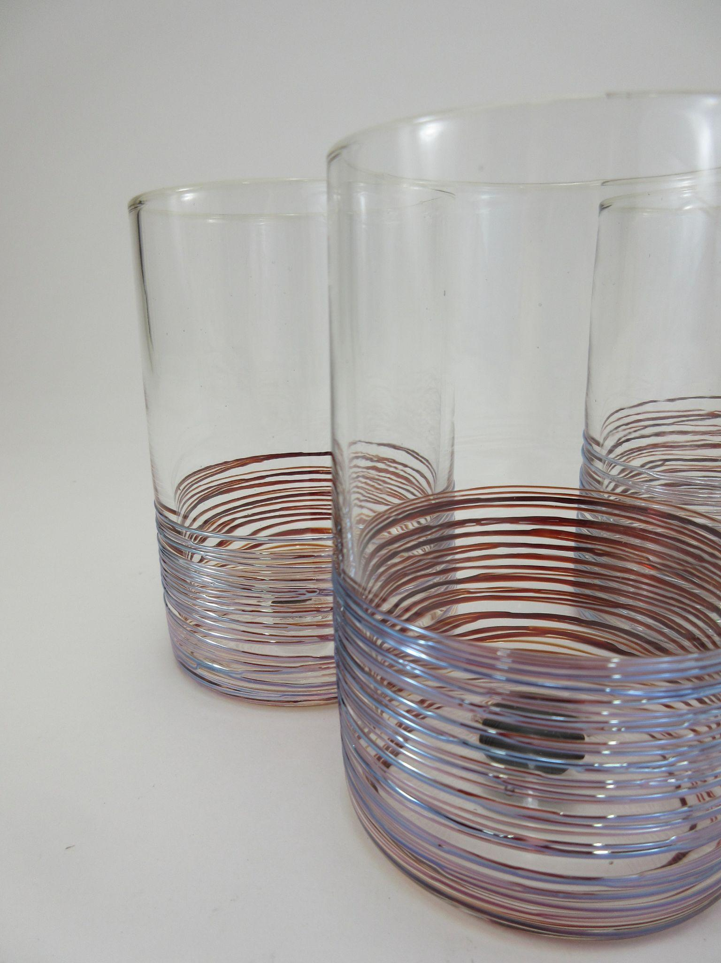
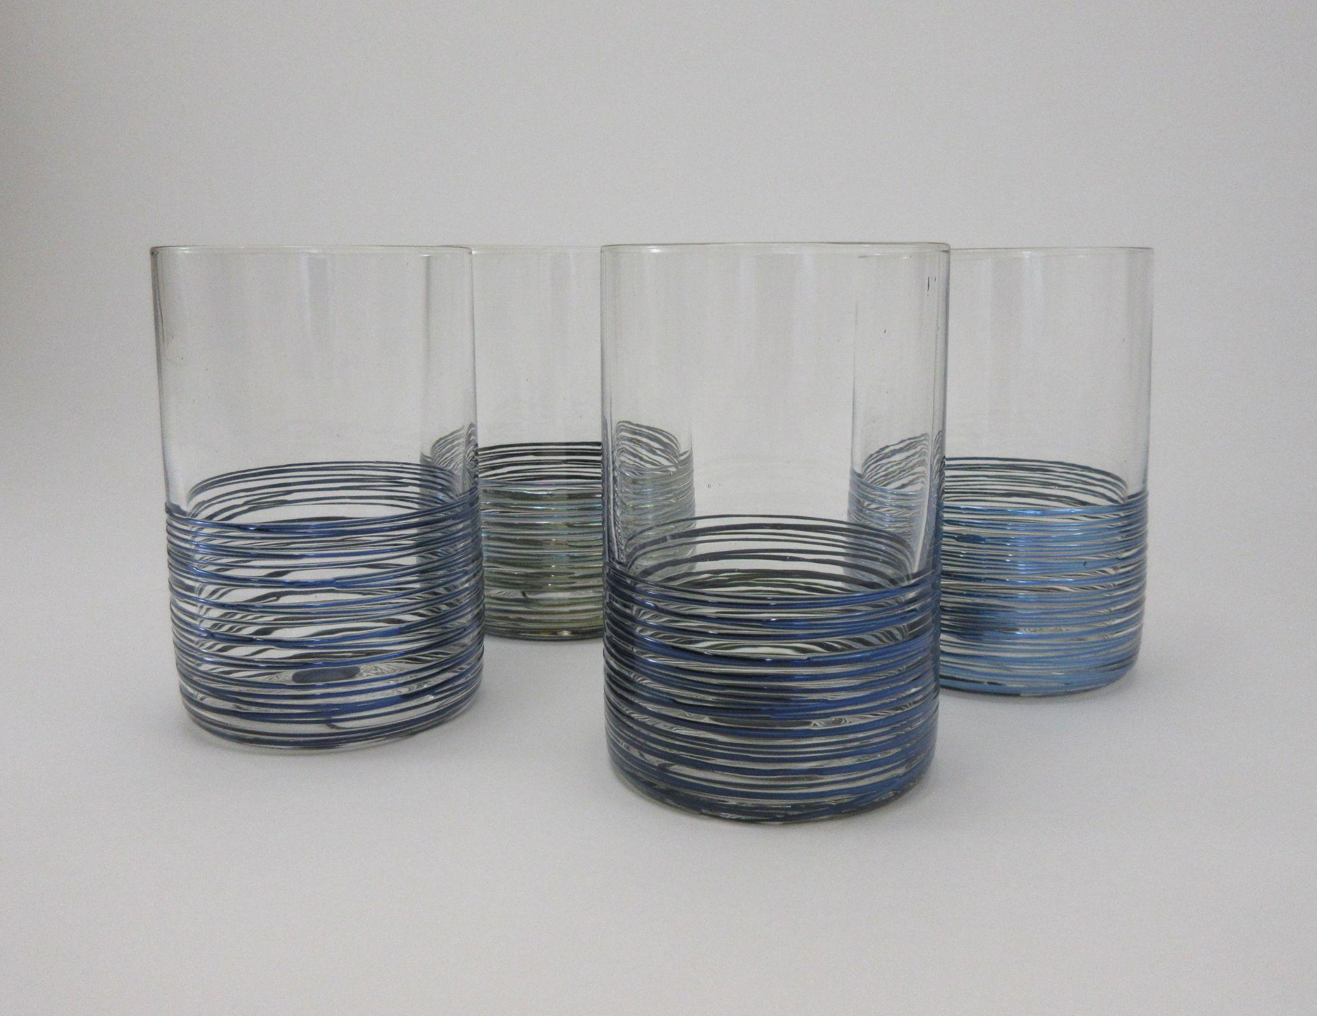
Notes:
In the video you just watched we were making this line of drinkware called Wrapped Tumblers. While the hot shop part is fascinating, there’s another half to the process that you don’t see that includes cutting, grinding and polishing the glass to finish it. We pride ourselves on a high quality finish for our drinkware and many people don’t believe that these are handmade since they look so clean… but they are.

Slide 6
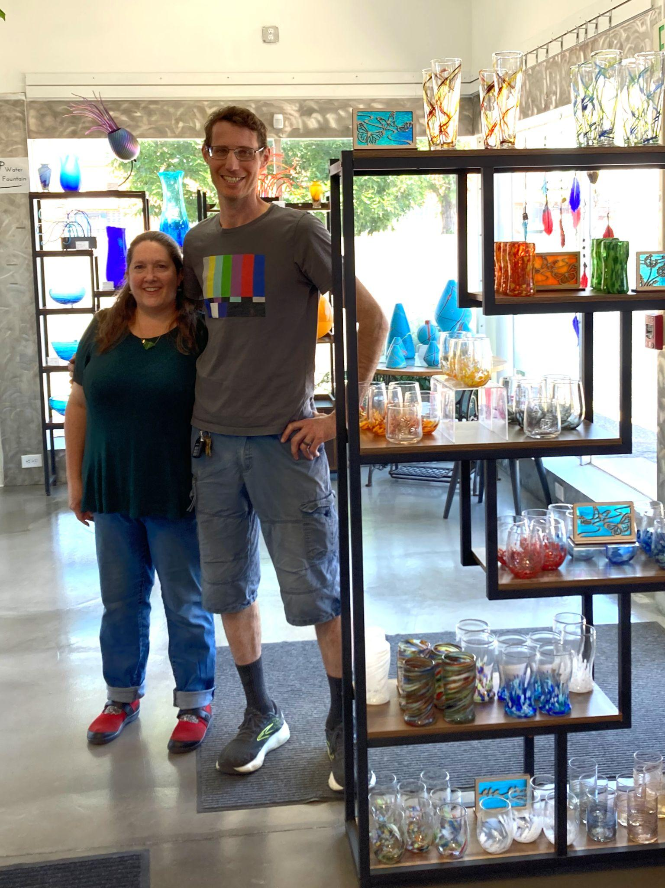
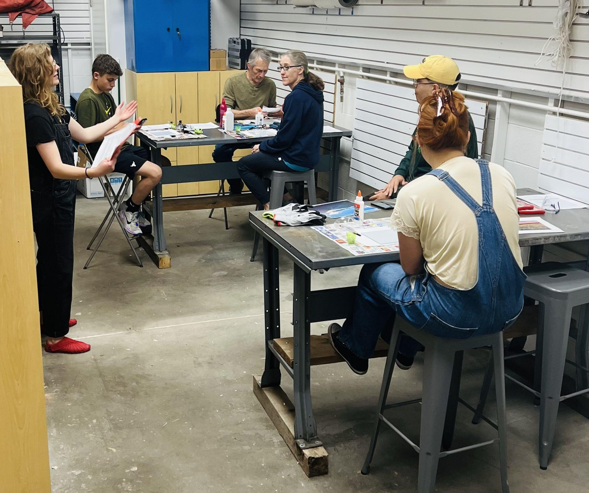
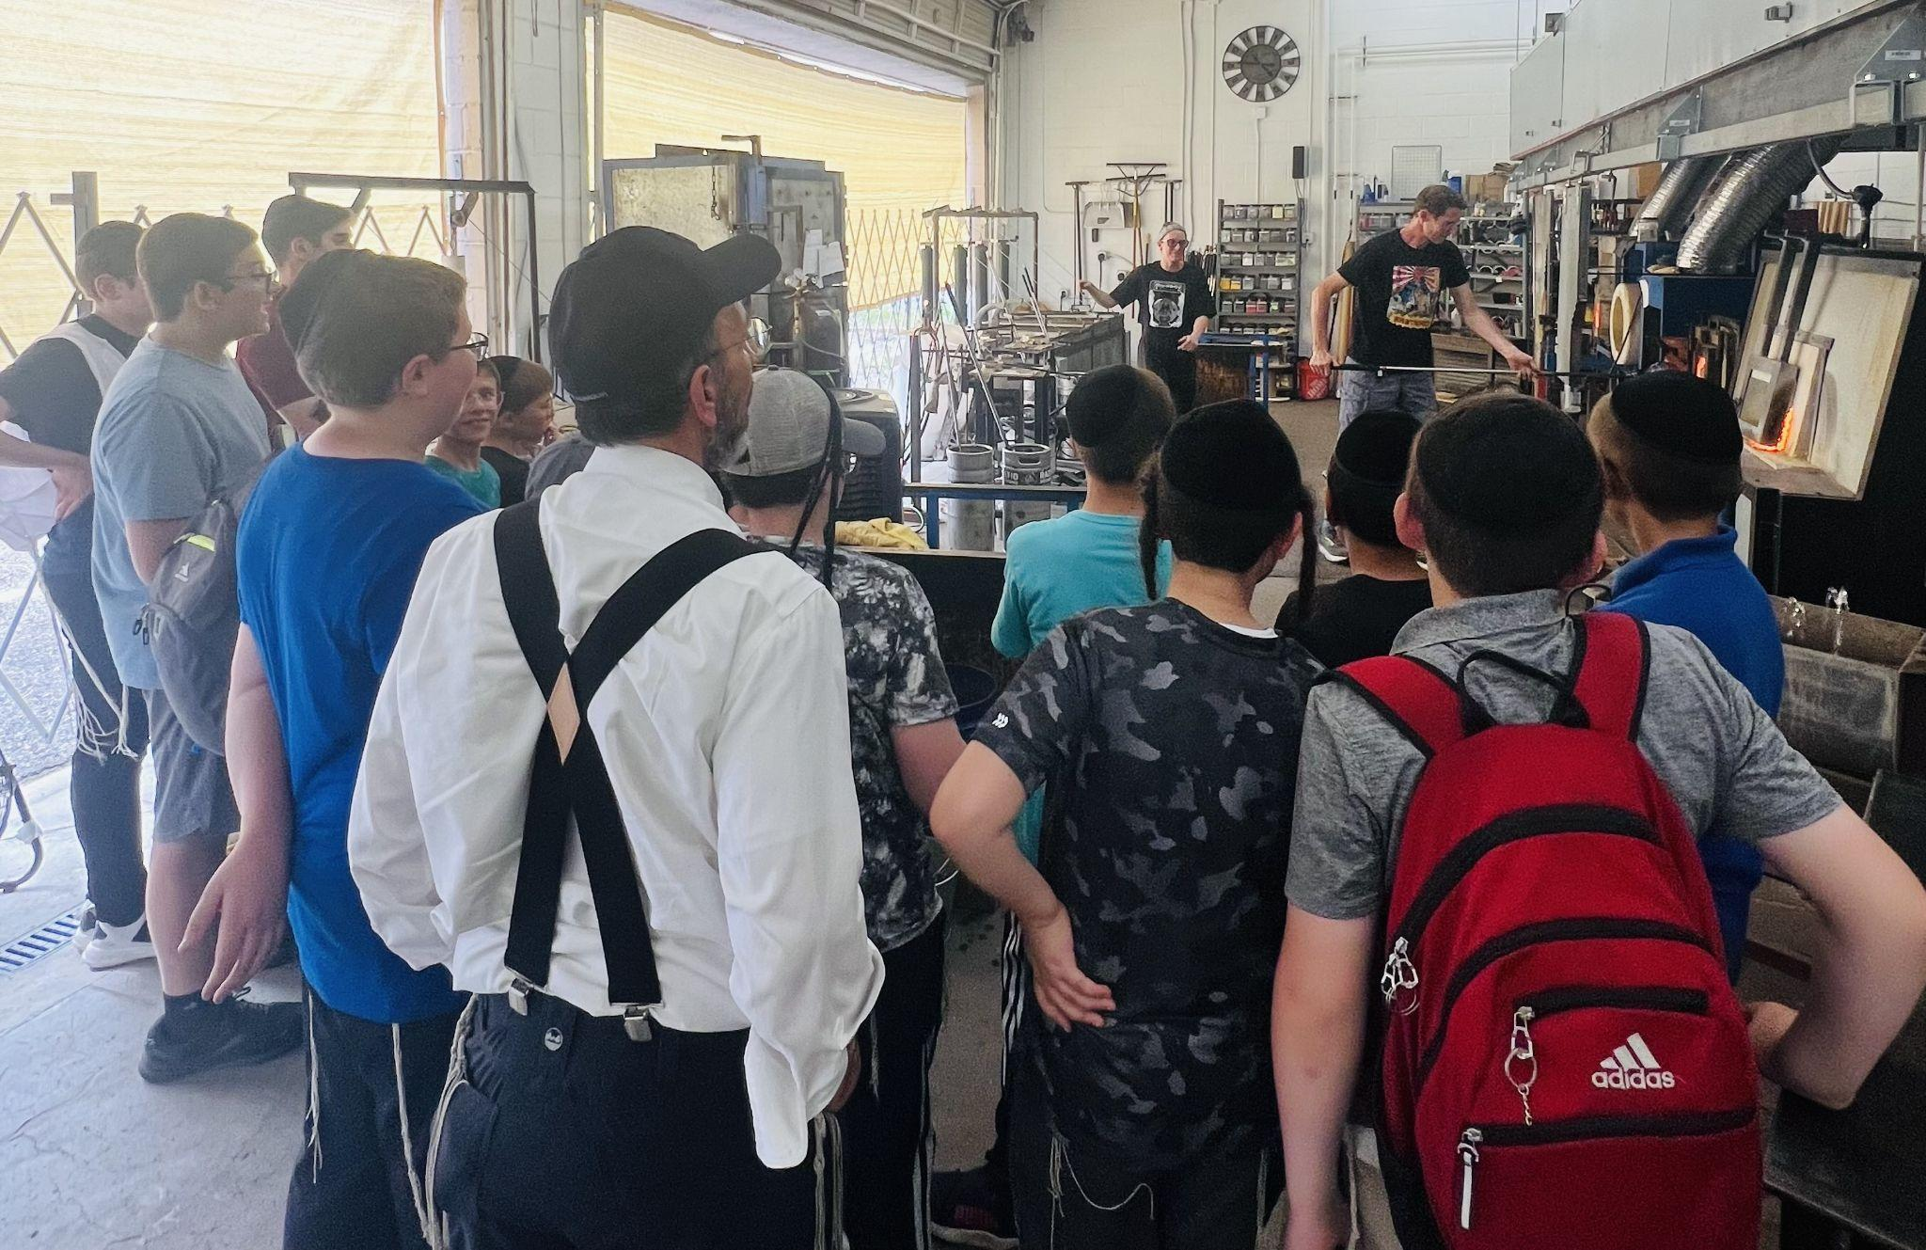
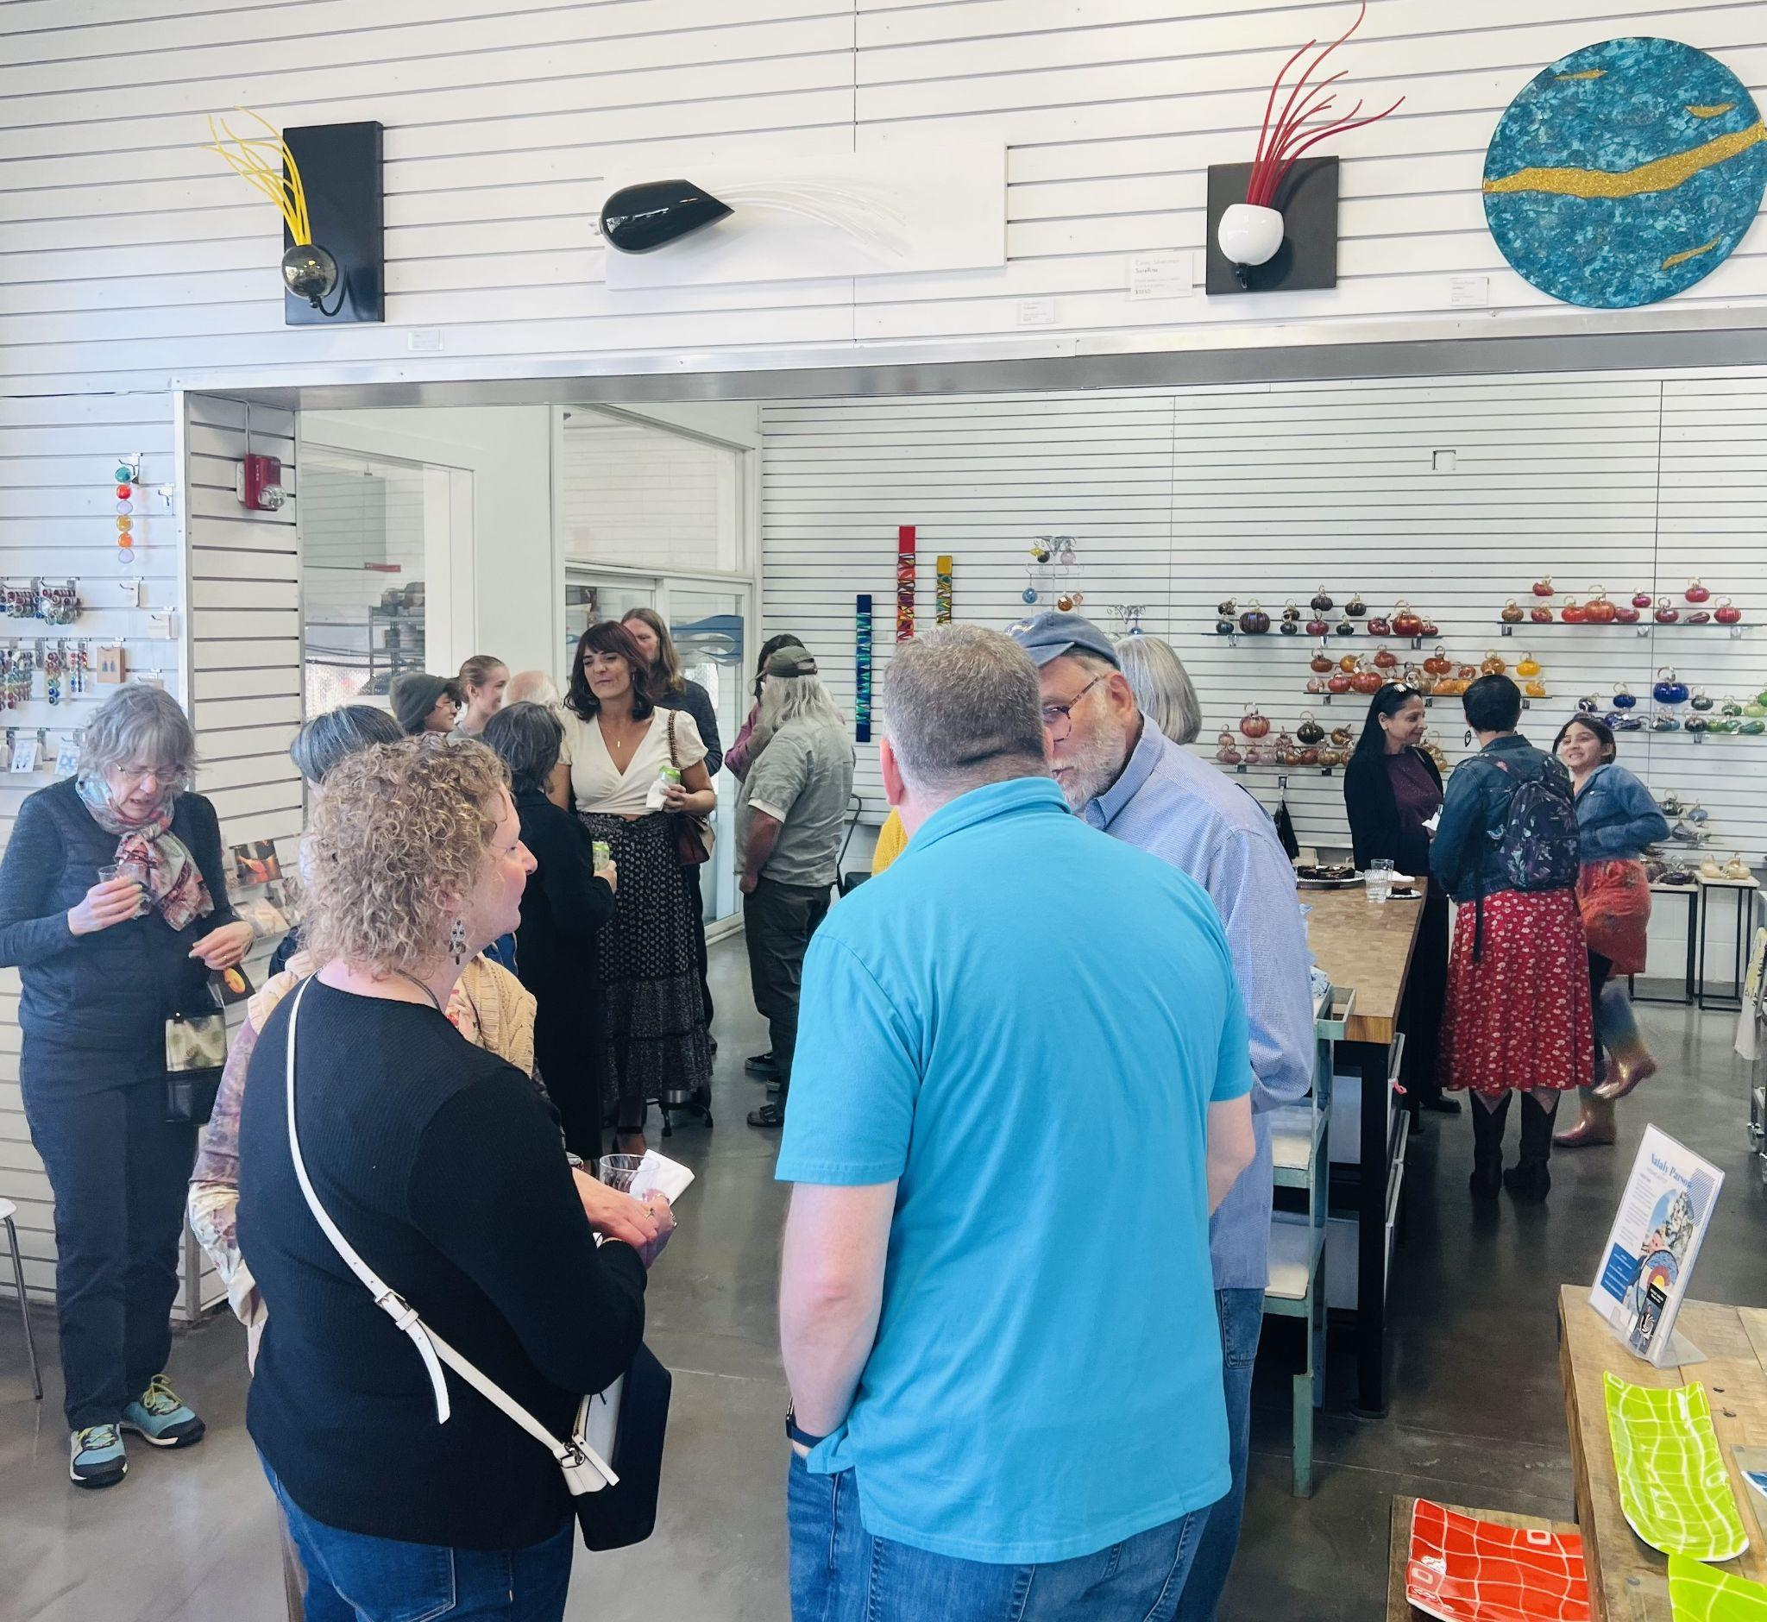
Notes:
Thank you for listening and we hope to see you all very soon in our gallery and hot shop. We are proud to be part of the 40W district and Lakewood business community. Let us know if you or anyone else you know would like to host or a team building event at our business.

Slide 7
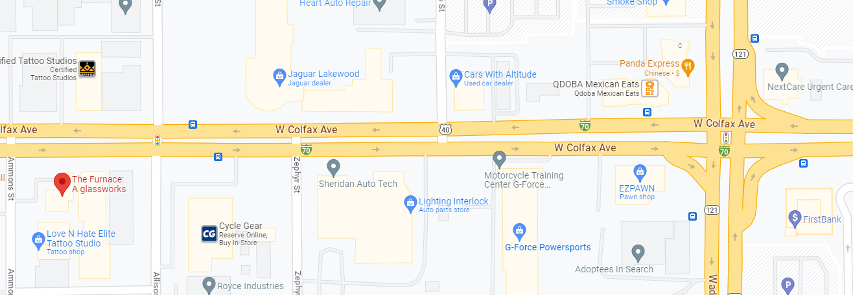
Notes:
Check out our website for more details

